Slide 1
Intelligent Energy scenario analysis
Group members
FA21/BSSE/136 Muhammad Farzam Baig
FA21/BSSE/138 Muhammad Suffian Tafoor
FA21/BSSE/139 Muhammad Yasir Khan
Supervisor
Dr M Shaheen Khan
Co-Supervisor
Mr M Usman Khan

Slide 2
Introduction
Intelligent Energy Scenario Analysis (IESA) is an AI-based business intelligence project that will revolutionize energy scenario analysis by utilizing WisRule, Linear regression, K Means Clustering, etc.
IESA aims to predict future scenarios related to energy, such as gas and electricity production and consumption, as well as associations between energy import, generation, and production, etc..
IESA is a DSS (Decision Support System) which enables optimal decision-making for sustainability and cost efficiency.
The project will analyze historical energy data to predict future needs and offer personalized recommendations, helping users to take better future decisions.

Slide 3
Problem Statement
Existing Decision Support systems lack accurate forecasting, and actionable insights for energy savings. These system are quite expensive in term of their licensing and are complex making it difficult to learn about it. They are also unable to provide dynamic predictions and personalized recommendations. This leads to inefficient resource allocations, increased cost and limited environmental benefits. IESA addresses these problems with cost-effective and user-friendly solution that supports the data-driven decisions.

Slide 4
Proposed Solution
Our project, Intelligent Energy Scenario Analysis, aims to address these challenges by developing a user-friendly, and cost-effective energy scenarios dashboard. Implemented in PowerBI and powered by custom Python algorithms, the dashboard will:
Provide an AI-driven intuitive interface to reduce the learning curve.
Quick data processing and analytics for immediate insights.
Automate data preprocessing and integration using AI.
Utilize machine learning for predictive maintenance and anomaly detection.
Enable user-centric customization of dashboards and reports.
Feature advanced data visualization techniques for effective presentation.
Deliver actionable recommendations for energy efficiency.
By integrating these innovative features, our solution will offer a comprehensive, accessible, and intelligent approach to energy consumption analysis and optimization.

Slide 5
Stakeholders
ID | Stakeholders | Type
ST01 | Our FYP group | Technical member
ST02 | Supervisor | Technical Team
ST03 | Co-Supervisor | Technical Team
ST04 | Evaluators | Technical Team
ST05 | Input Entry Operator | End User
ST06 | Energy Planner | End User

Slide 6
Project Features
ID | Feature | Description
FT01 | Energy Data Acquisition | This feature interacts with user to get input data from user through csv/xml.
FT02 | Energy Data Storage | This units extracts data from csv/xml inputted by user and stores in Database.
FT03 | ETL | This Module extracts data from database transforms it and loads into our system.
FT04 | Scenario Analysis | The system must analyze historical data and generate patterns for production and consumption, as well as associations between energy import, generation, and production etc.
FT05 | Prediction Engine | The system must use WisRule, Linear Regression, K Means Clustering for prediction based on different scenarios
FT06 | Data Visualization | The system must visualize both historical data and predicted data on dashboard using graphs and charts.
FT07 | Reporting | The system must allow to share and print reports both in hard and soft form.
FT08 | Personalized Recommendations | The system must provide user with recommendations for future decision based on historical and predicted data.

Slide 7
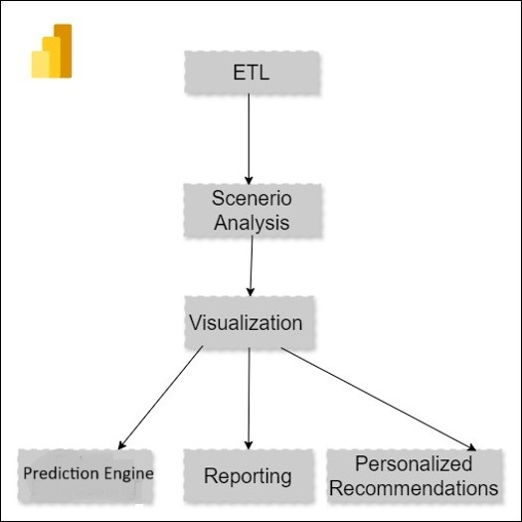
Block Diagram / Concept Diagram

Slide 8
Design Methodology
IESA follows the Structural programming approach. In structural programming, we divide a program in modules and each module is a software component or a part of program that contains one or more function, procedure, or method. IESA contains modules and each module serves separate operation

Slide 9
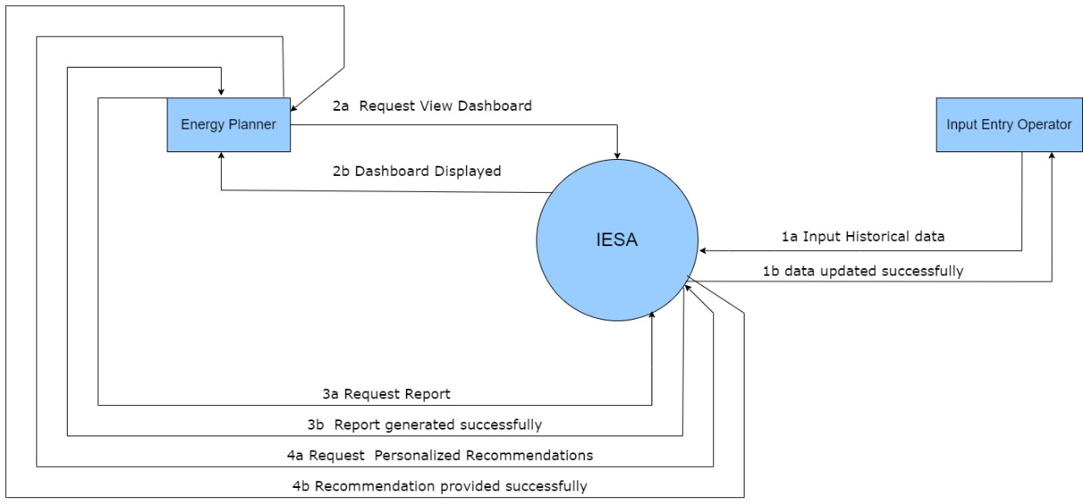
Use Case / context diagram

Slide 10
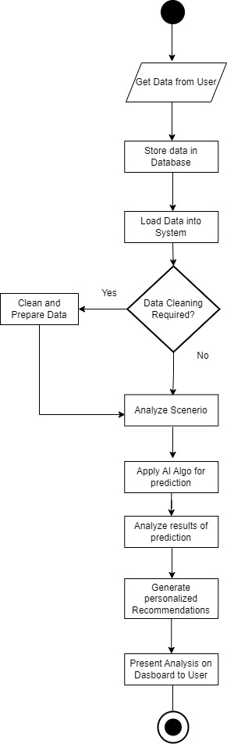
System Sequence Diagram / Flow model

Slide 11
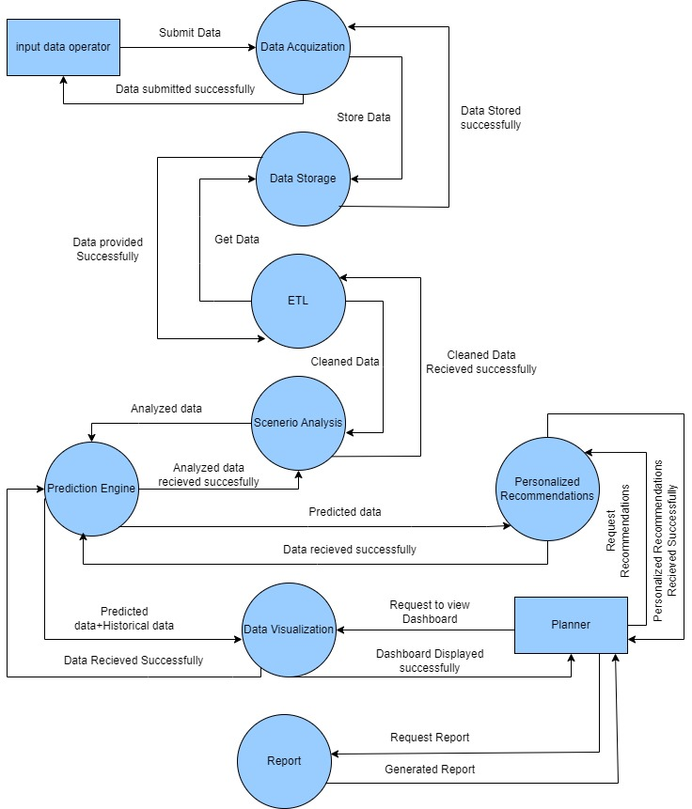
Sequence Diagram/ DFD LEVEL 1

Slide 12
Tools and tech
Database: MS SQL Server
Tools: PowerBI, PyCharm/VS Code, MS-SSMS
Programming Language: Python

Slide 13
Benchmarking
Features | LoadSEER | EnergyPLAN | HOMER Pro | PLEXOS | OSET | LEAP | ETAP | Siemens PSS/E | Our System
Historical Data Visualization | ✗ | ✓ | ✓ | ✓ | ✗ | ✓ | ✓ | ✓ | ✓
Prediction Modeling | ✓ | ✓ | ✓ | ✓ | ✓ | ✓ | ✓ | ✓ | ✓
Scenario Analysis | ✓ | ✓ | ✓ | ✓ | ✓ | ✓ | ✓ | ✓ | ✓
Recommendations and Insights | ✗ | ✗ | ✗ | ✓ | ✗ | ✗ | ✗ | ✓ | ✓
Data Visualization in Dashboards | ✗ | ✗ | ✓ | ✗ | ✗ | ✗ | ✓ | ✗ | ✓
Exportable Reports | ✗ | ✗ | ✓ | ✓ | ✗ | ✗ | ✓ | ✓ | ✓
Comparison among Scenarios | ✓ | ✗ | ✓ | ✓ | ✓ | ✗ | ✓ | ✓ | ✓
Notes:
Loadseer Energy Plan: Loadseer is an advanced grid analytics platform focused on distributed energy resources (DER) planning and forecasting. It helps utilities optimize their energy grid by providing insights into load growth, solar adoption, and electric vehicle impacts.
Homer Pro: HOMER (Hybrid Optimization of Multiple Energy Resources) Pro is a microgrid modeling tool that assists in designing and optimizing hybrid power systems. It evaluates renewable energy sources, storage, and conventional generators to determine the most cost-effective configurations.
PLEXOS: PLEXOS is an integrated energy modeling tool used for power market simulation, capacity planning, and operational analysis. It enables utilities, regulators, and market participants to analyze energy production, consumption, and trade at a detailed level.
LEAP (Long-range Energy Alternatives Planning System): LEAP is a scenario-based energy-environment modeling tool that helps policymakers and analysts evaluate energy systems and environmental impacts. It is widely used for national and regional energy planning.
ETAP (Electrical Transient and Analysis Program): ETAP is a comprehensive power system design and simulation software. It covers areas like load flow analysis, transient stability, and protection coordination, supporting engineers in designing and maintaining efficient and reliable power systems.
Siemens PSS/E (Power System Simulator for Engineering): Siemens PSS/E is a leading software tool for transmission planning and operational studies. It provides capabilities for load flow analysis, stability simulations, and system optimization, enabling utilities to plan and ensure grid reliability.

Slide 14
Functional Requirements
ID | Description | Feature
FR01 | The system shall allow user to input historical data in form of csv/xml. | FT01
FR02 | The System shall store input data in database. | FT02
FR03 | The System shall extract data from database clean it and prepare it and load it into system | FT03
FR04 | The system shall analyze historical data and generate patterns for different energy scenarios. | FT04
FR05 | The system shall use WisRule, K mean cluster, Linear Regression and other algorithms to predict future energy related scenarios. | FT05
FR06 | The system shall visualize both historical data, different scenarios and predicted data on dashboard using graphs and charts. | FT06
FR07 | The system shall allow to share and print reports both in hard and soft form. | FT07
FR08 | The system shall provide user with recommendations for future decision based on historical and predicted data. | FT08

Slide 15
Non-Functional Requirements
ID | NFR | Statement
NFR01 | Response Time | The system should generate energy scenario report with in 15 seconds after user input’s data.
NFR02 | Performance | The system should be able to handle up to 10 parallel user without and performance degradation.
NFR03 | Availability | The system should be available for user’s 24/7
NFR04 | Ease of use | Thes system should allow user to perform most of the functionality within 5 minutes of first use
NFR05 | Maintainability | The system should be modular and well documented with easily updateable and maintainable components

Slide 16
Constraints
ID | Constraint | Description
S01 | Scope | The scope is limited to associative mining and predicting production and consumption related scenrios of gas and electricity only.
S02 | Tools | The system must have tools like Python for data processing and MS SQL for database.
S03 | Processing capabilities | The system should support concurrent processing for multiple scenario analyses running simultaneously.
S04 | Cost | The Cost should cater both cost of Research and development, Deployment and maintenance

Slide 17
Functionality Classification
ID | Description | Classification
FR01 | The system shall allow user to input historical data in form of csv/xml. | User
FR02 | The System shall store input data in database. | System
FR03 | The System shall extract data from database clean it and prepare it and load it into system | System
FR04 | The system shall analyze historical data and generate patterns for different energy scenarios. | System
FR05 | The system shall use WisRule, K mean cluster, Linear Regression and other algorithms to predict future energy related scenarios. | System
FR06 | The system shall visualize both historical data, different scenarios and predicted data on dashboard using graphs and charts. | System
FR07 | The system shall allow to share and print reports both in hard and soft form. | User
FR08 | The system shall provide user with recommendations for future decision based on historical and predicted data. | User

Slide 18
Traceability
Requirement ID | Requirement Description | Feature ID | Feature Description | Verification Method
FR01 | The system shall allow user to input historical data in CSV/XML format. | FT01 | Data Input Interface for uploading historical data files. | System Test: Data upload
FR02 | The System shall store input data in database. | FT02 | Data Storage functionality in MS SQL database. | Database Test: Data storage
FR03 | The System shall extract data from database clean it and prepare it and load it into system | FT03 | ETL Process: Data cleaning and loading. | System Test: ETL process
FR04 | The system shall analyze historical data and generate patterns for different energy scenarios. | FT04 | Analytical Module for historical pattern generation. | System Test: Scenarios Analysis
FR05 | The system shall use WisRule, K mean cluster, Linear Regression and other algorithms to predict future energy related scenarios. | FT05 | Forecasting using WisRule and other algorithms for future energy trends. | Algorithm Test: Compare prediction accuracy
FR06 | The system shall visualize both historical data, different scenarios and predicted data on dashboard using graphs and charts. | FT06 | Dashboard for data visualization using graphs and charts. | UI Test: Dashboard visuals
FR07 | The system shall allow to share and print reports both in hard and soft form. | FT07 | Reporting Module for hard and soft copy outputs. | System Test: Report generation
FR08 | The system shall provide user with recommendations for future decision based on historical and predicted data. | FT08 | Recommendation Engine for decision support. | System Test: Recommendations

Slide 19
Gantt Chart

Slide 20
Group LOG
Serial Number | Meeting Date | Meeting Attendees | Location | Minutes
1 | 7/10/2024 | Muhammad Suffian Muhammad Yasir Muhammad Farzam Muhammad Shaheen | University | Discussed The idea and project scope of IESA also given shown some samples dashboard to Sir Shaheen
2 | 16/10/2024 | Muhammad Suffian Muhammad Yasir Muhammad Farzam | Online | Discussed WisRule algorithm and other Features od IESA
3 | 22/10/2024 | Muhammad Suffian Muhammad Yasir Muhammad Farzam Muhammad Shaheen | University | Show version 1.2 and asked for improved
4 | 28/10/2024 | Muhammad Suffian Muhammad Yasir Muhammad Farzam Muhammad Shaheen | University | Shown version 1.3 and asked for improved
5 | 31/10/2024 | Muhammad Suffian Muhammad Yasir Muhammad Farzam | Online | Discussed SRS v1.4 and gave finishing touch
6 | 21/11/2024 | Muhammad Suffian Muhammad Yasir Muhammad Farzam Muhammad Shaheen | University | Discussed final SRS and got approval from Dr Shaheen

Slide 21
Group LOG(Work Division)
SRS Documentation Contribution | Member | Work Done
 | Muhammad Suffian Tafoor | Chapter 3 & 2 (Product Functionality & operating environment )
 | Muhammad Farzam Baig | Chapter 1 and 4
 | Muhammad Yasir Khan | Chapter 2 & 3 (User Interfaces)

Slide 22
References
LEAP: Long-range Energy Alternatives Planning System. Retrieved from https://www.energycommunity.org/default.asp?action=LEAP
EnergyPLAN: Retrieved from https://www.energyplan.eu/
HOMER Pro: Retrieved from https://www.homerenergy.com/products/pro/
PLEXOS: Retrieved from https://www.energyexemplar.com/solutions/plexos
Open Source Energy Modelling System: Retrieved from https://oset.org/
LoadSEER: Retrieved from https://www.integralanalytics.com/loadseer/
ETAP: Retrieved from https://etap.com/
Seimens PSS/E: Retrieved from https://new.siemens.com/global/en/products/energy/services/transmission-distribution-smart-grid/consulting-and-planning/pss-software.html

Slide 23

]
CCP(complex computing problem) Characteristic | Explanation | Tick/Cross
Range of Conflicting Requirements | Our system integrates both gas and electricity data, optimizes energy usage, and balances real-time versus historical analysis, creating technical conflicts. | ✓
Depth of Analysis Required | The system involves complex data analysis, including machine learning for predictive modeling, scenario analysis, and generating recommendations. | ✓
Depth of Knowledge Required | To perform analysis on different energy scenarios dept of knowledge of Energy domain and different Algos is required. | ✓
Familiarity of Issues | Integration of gas and electricity data with user-friendly features is less common, introducing novel challenges. | x
Level of Problem | The problem is a national level problem outside the scope of standard energy DSS tools, involving quick processing while implementing advanced analytics. | ✓
Extent of Stakeholder Involvement & Conflicts | Involves fewer stakeholders with no major confliction | x
Consequences | Significant consequences for energy efficiency, cost savings, and environmental impact; decisions based on your system have wide-ranging effects. And incase of wrong analysis it can cause hazard. | ✓
Interdependence | The system consists of interdependent components (data collection, processing, predictive modeling, visualization) that must work together effectively. | ✓
Requirement Identification | Requirements, especially those related to user-specific needs and real-time data integration, may evolve as the project progresses. | x

Slide 24
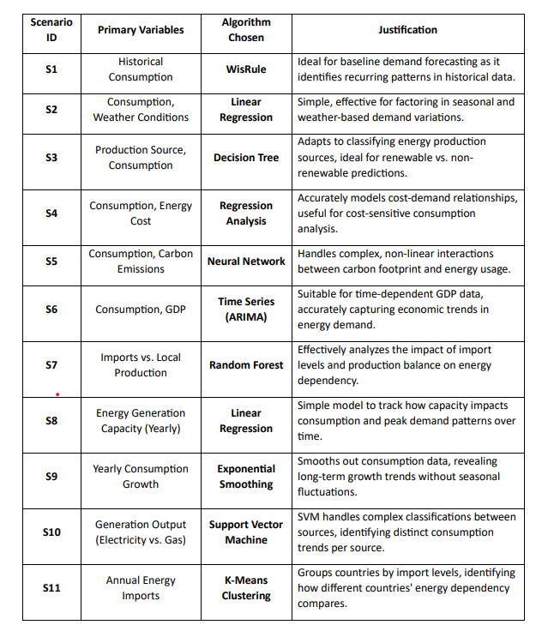
]
Scenarios

Slide 25
IESA vs EnergyPlan
Features | EnergyPLAN | Our System
Historical Data Visualization | ✗ | ✓
Prediction Modeling | ✓ | ✓
Scenario Analysis | ✓ | ✓
Recommendations and Insights | ✗ | ✓
Data Visualization in Dashboards | ✗ | ✓
Exportable Reports | ✗ | ✓
Comparison among Scenarios | ✗ | ✓

Slide 26
IESA vs Homer Pro
Features | HOMER Pro | Our System
Historical Data Visualization | ✓ | ✓
Prediction Modeling | ✓ | ✓
Scenario Analysis | ✓ | ✓
Recommendations and Insights | ✗ | ✓
Data Visualization in Dashboards | ✓ | ✓
Exportable Reports | ✓ | ✓
Comparison among Scenarios | ✓ | ✓

Slide 27
IESA vs Plexos
Features | PLEXOS | Our System
Historical Data Visualization | ✓ | ✓
Prediction Modeling | ✓ | ✓
Scenario Analysis | ✓ | ✓
Recommendations and Insights | ✓ | ✓
Data Visualization in Dashboards | ✗ | ✓
Exportable Reports | ✓ | ✓
Comparison among Scenarios | ✓ | ✓

Slide 28
IESA vs OSET
Features | OSET | Our System
Historical Data Visualization | ✗ | ✓
Prediction Modeling | ✓ | ✓
Scenario Analysis | ✓ | ✓
Recommendations and Insights | ✗ | ✓
Data Visualization in Dashboards | ✗ | ✓
Exportable Reports | ✗ | ✓
Comparison | ✓ | ✓

Slide 29
IESA vs LEAP
Features | LEAP | Our System
Historical Data Visualization | ✓ | ✓
Prediction Modeling | ✓ | ✓
Scenario Analysis | ✓ | ✓
Recommendations and Insights | ✗ | ✓
Data Visualization in Dashboards | ✗ | ✓
Exportable Reports | ✗ | ✓
Comparison among Scenarios | ✗ | ✓

Slide 30
IESA vs ETAP
Features | ETAP | Our System
Historical Data Visualization | ✓ | ✓
Prediction Modeling | ✓ | ✓
Scenario Analysis | ✓ | ✓
Recommendations and Insights | ✗ | ✓
Data Visualization in Dashboards | ✓ | ✓
Exportable Reports | ✓ | ✓
Comparison among Scenarios | ✓ | ✓

Slide 31
IESA vs SIEMENS PSS/E
Features | Siemens PSS/E | Our System
Historical Data Visualization | ✓ | ✓
Prediction Modeling | ✓ | ✓
Scenario Analysis | ✓ | ✓
Recommendations and Insights | ✓ | ✓
Data Visualization in Dashboards | ✗ | ✓
Exportable Reports | ✓ | ✓
Comparison among Scenarios | ✓ | ✓

